Slide 1
VIRTUAL REALITY AUGMENTED REALITY
Rafael Marcén
ALEJANDRO LATORRE
ISABEL AGUSTIN
Fernando Aliaga
adidas Hackathon 2018 | Barcelona

Slide 2

INTRODUCTION
VIRTUAL REALITY
AUGMENTED REALITY
AGENDA

Slide 3
1
Introduction

Slide 4
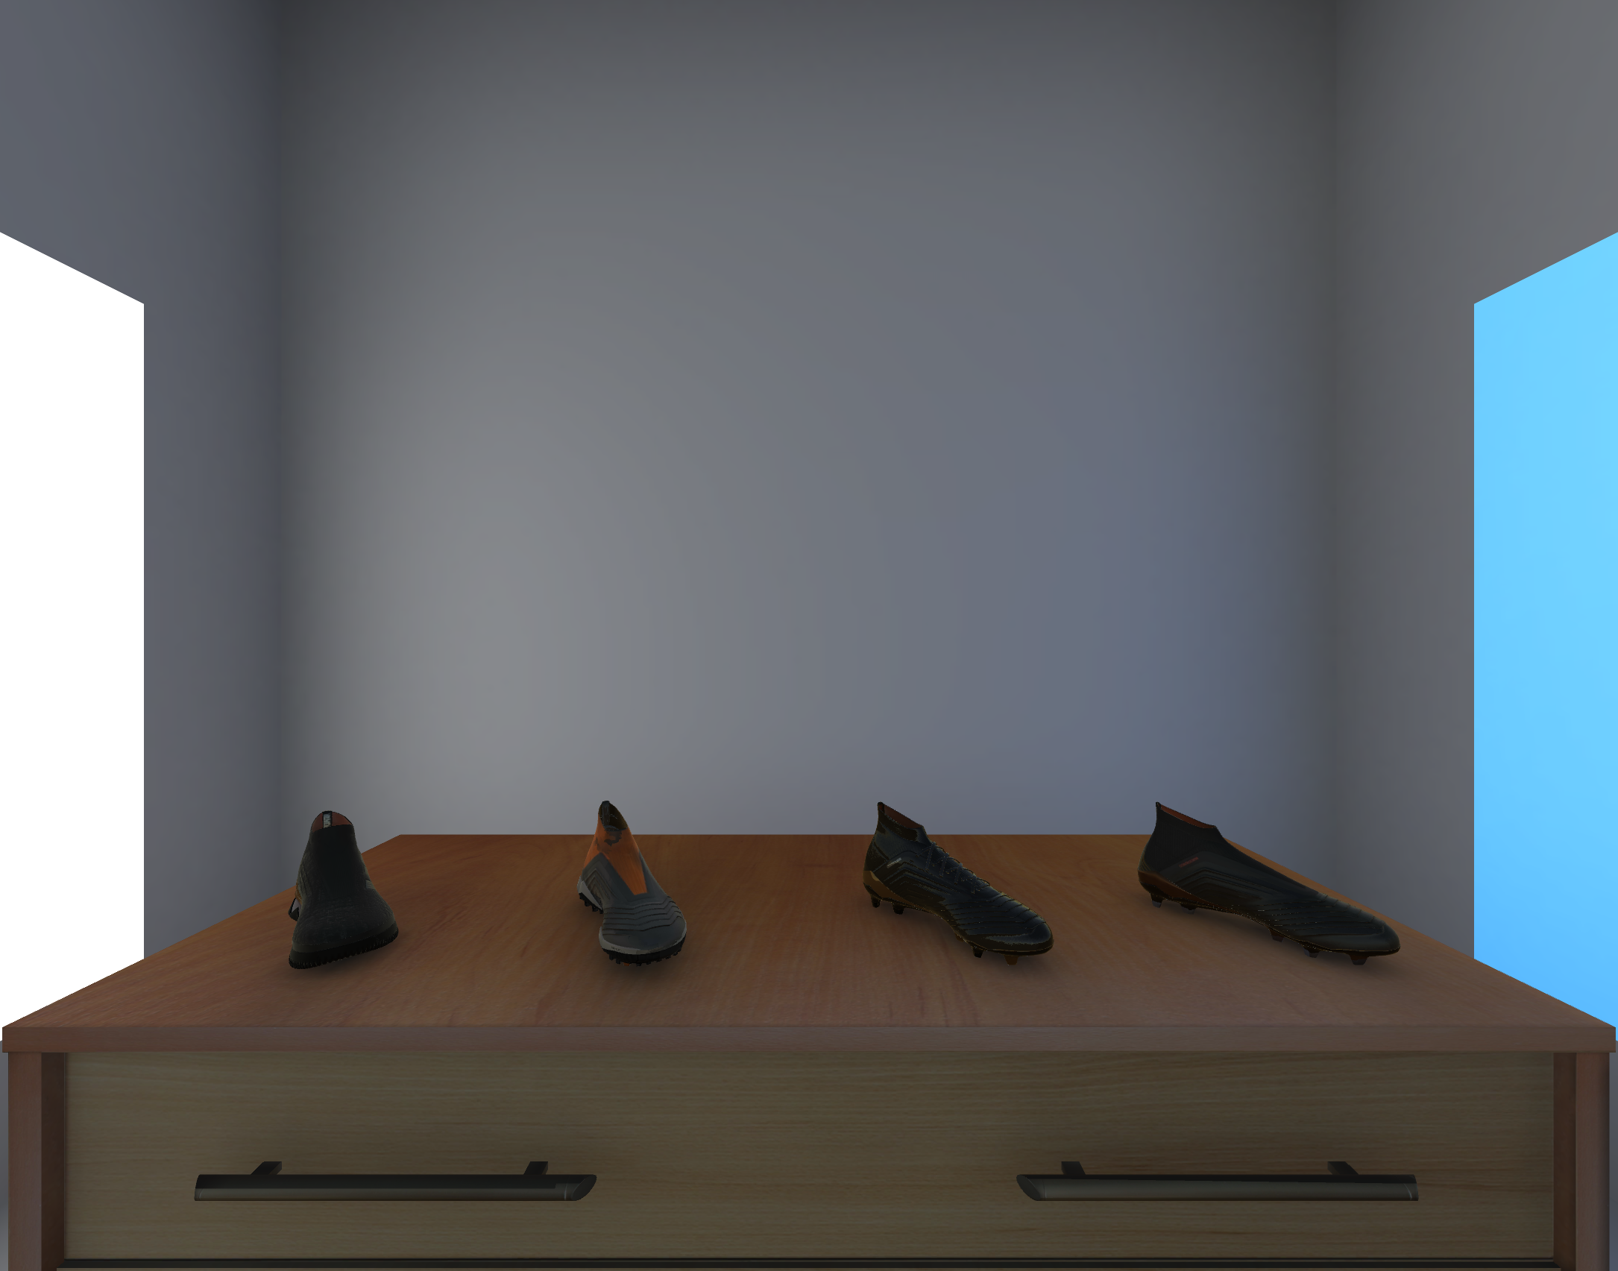
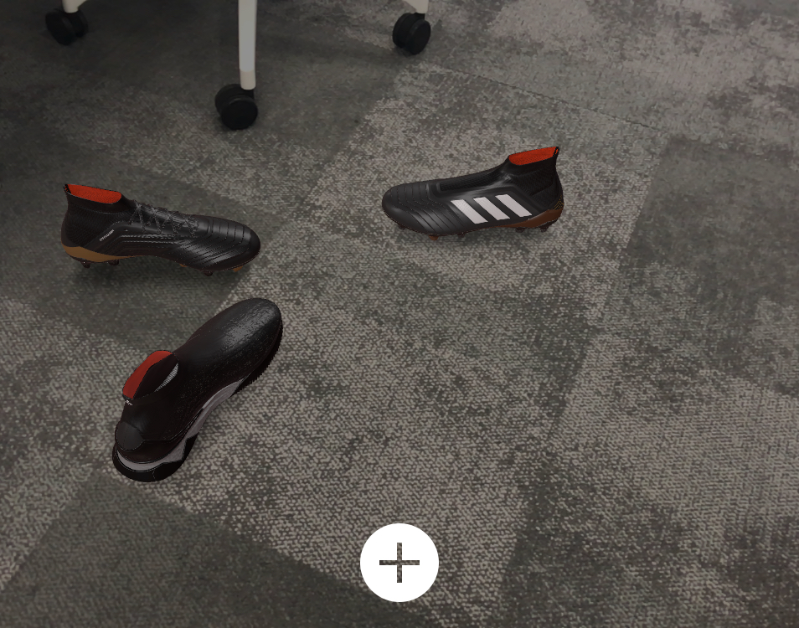
EXAMPLES
VIRTUAL REALITY
AUGMENTED REALITY

Slide 5
Creating new project from Scratch

Slide 6
2
Virtual Reality

Slide 7
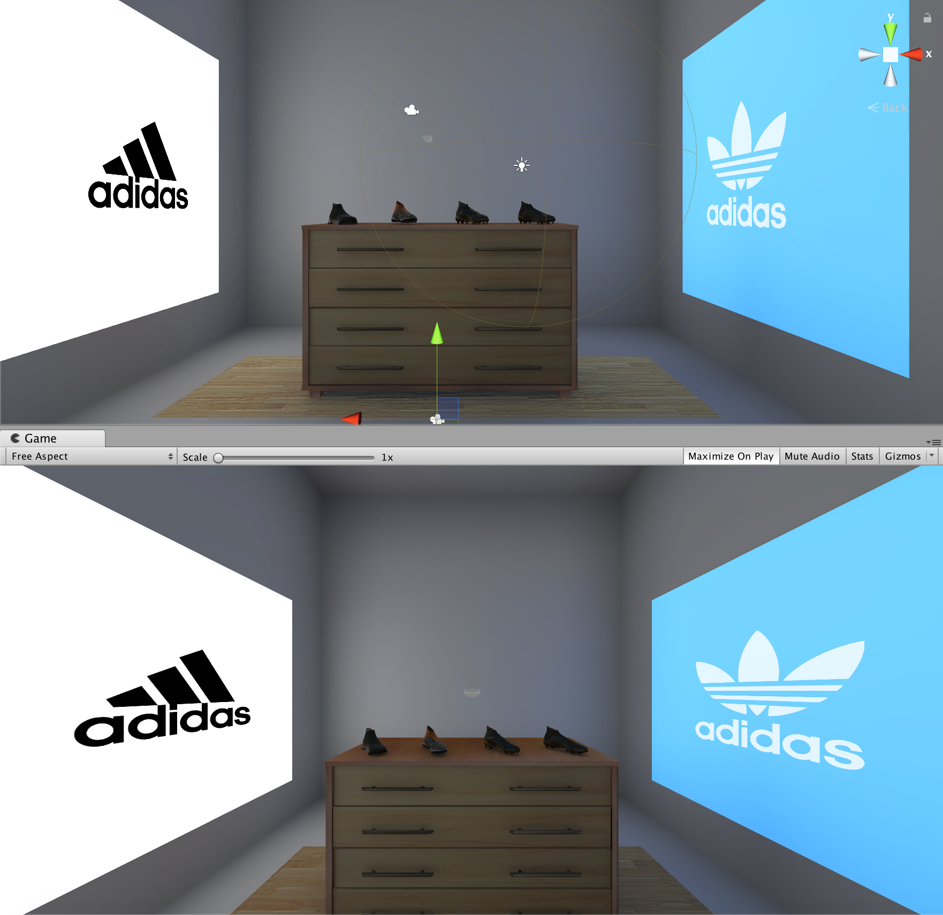
Virtual reality
Virtual World
Immersion
Sensor Feedback
Interactivity

Slide 8
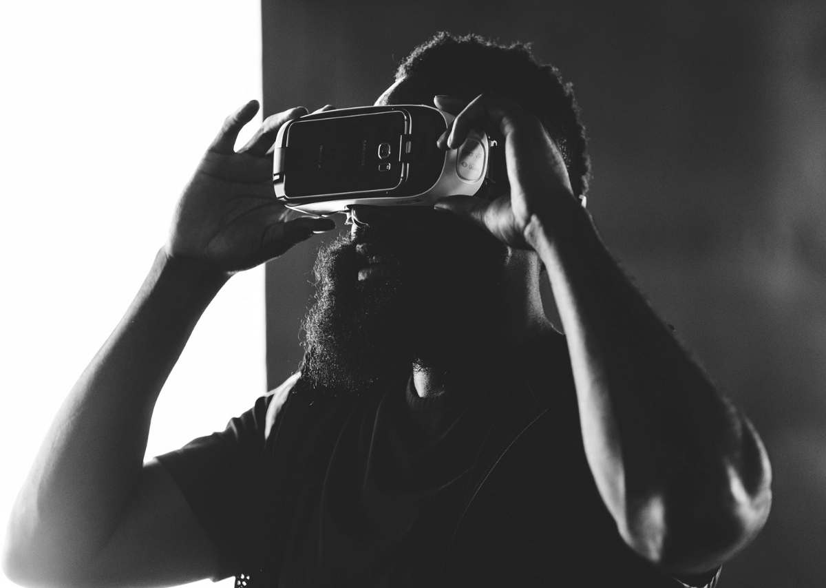
HEAD TRACKING
Y
X
Z

Slide 9

GOOGLE VR - platforms
Android
Unity
Unreal
iOS

Slide 10




REQUIREMENTS
Virtual Reality
x1 Pixel 1 / x1 Pixel 2 / x1 Samsung Galaxy S8
Own computers
Android 4.4 'Kit Kat' (API level 19) or higher
Github repo (PoC)
https://github.com/adidasBCNHackathon/AR-VR
Unity 5.6 or later with Android Build Support installed
x10 Cardboard
Google VR SDK for Unity
Android SDK

Slide 11
Demo google vr
Virtual reality

Slide 12
3
Augmented Reality

Slide 13
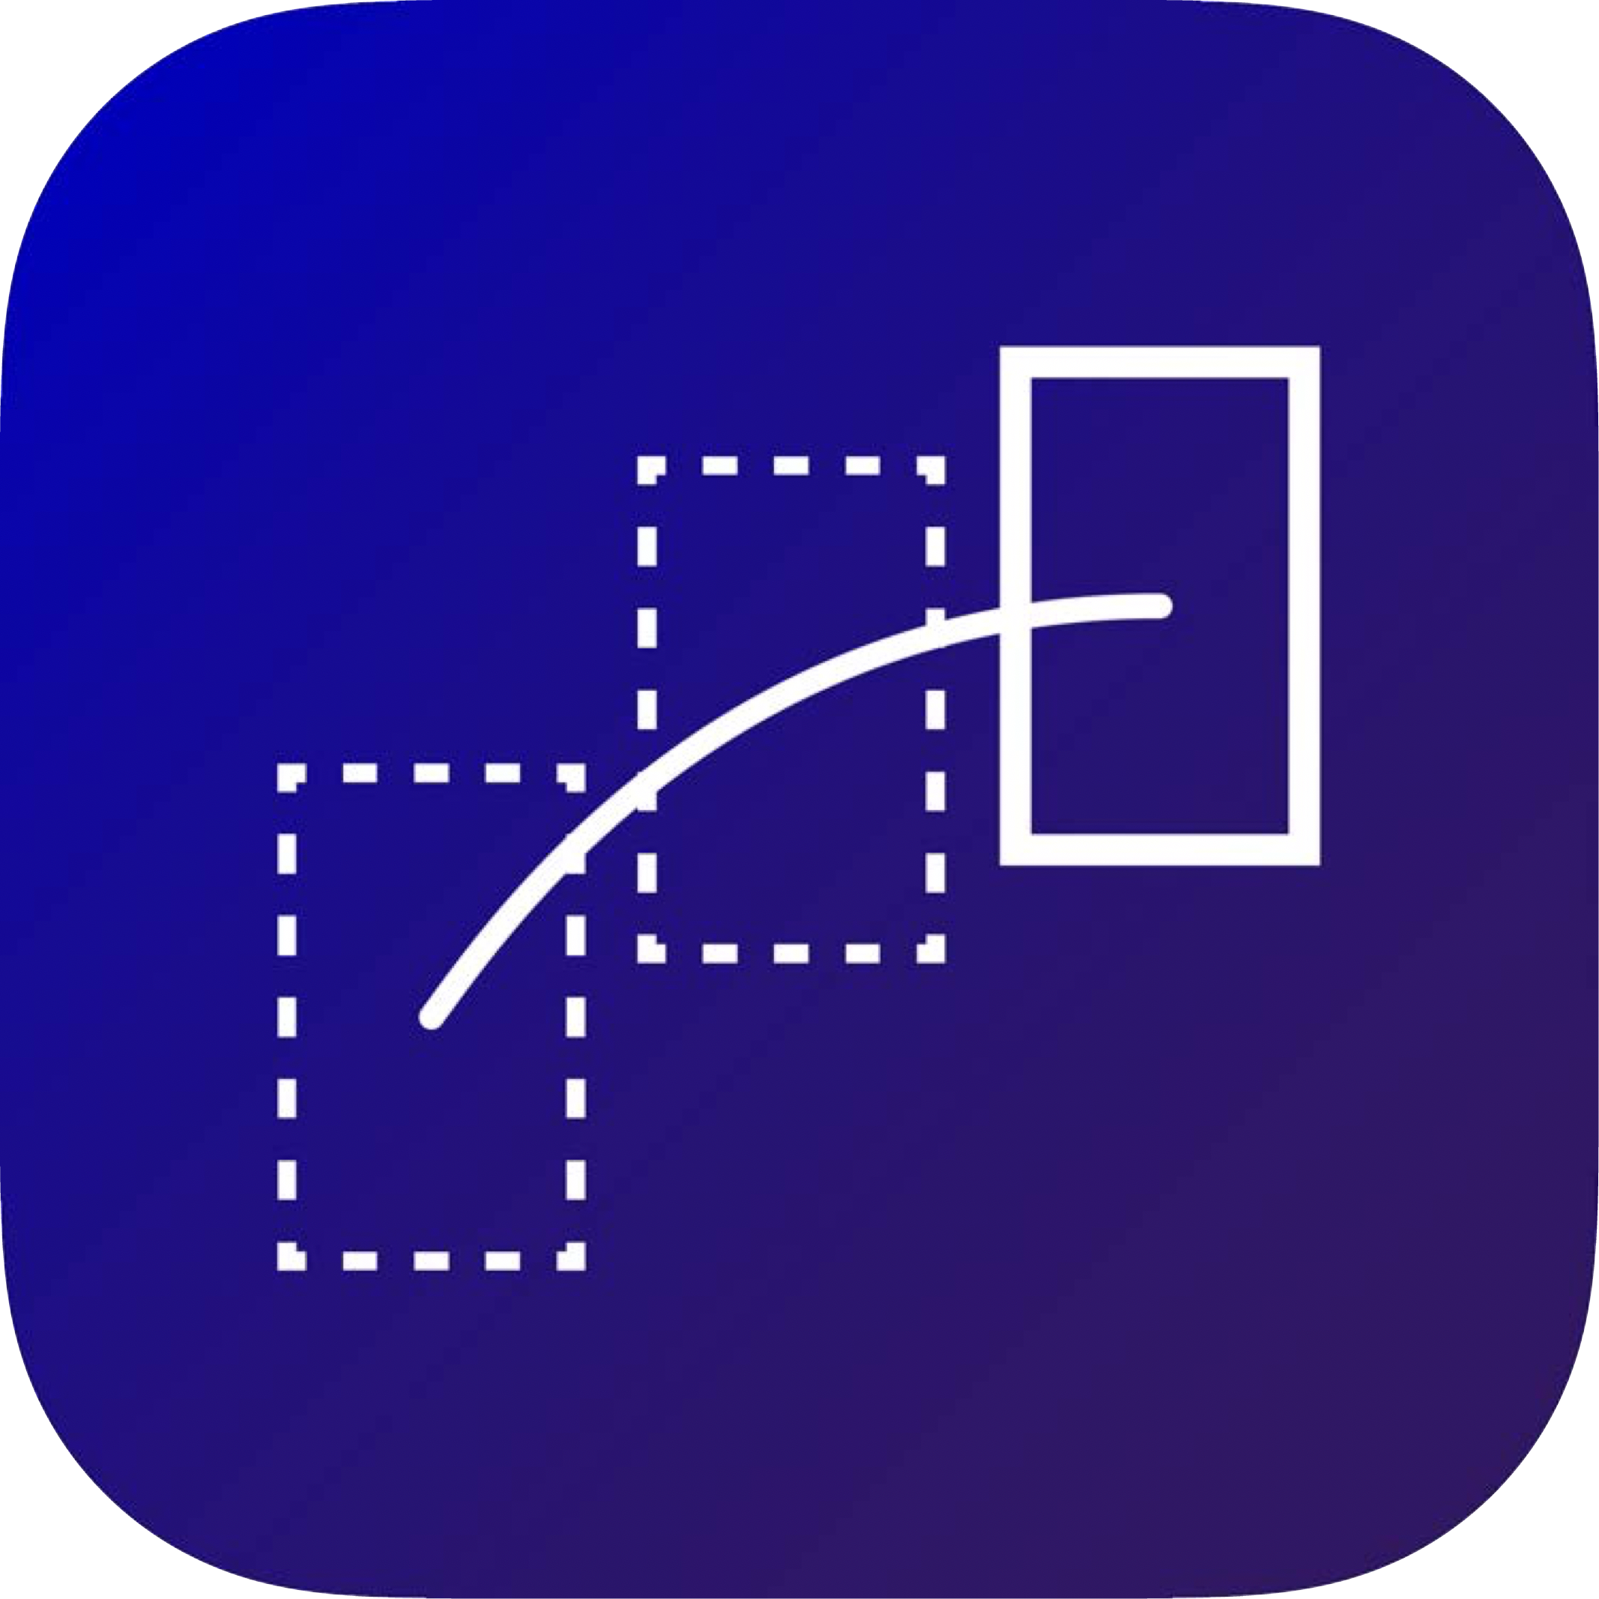

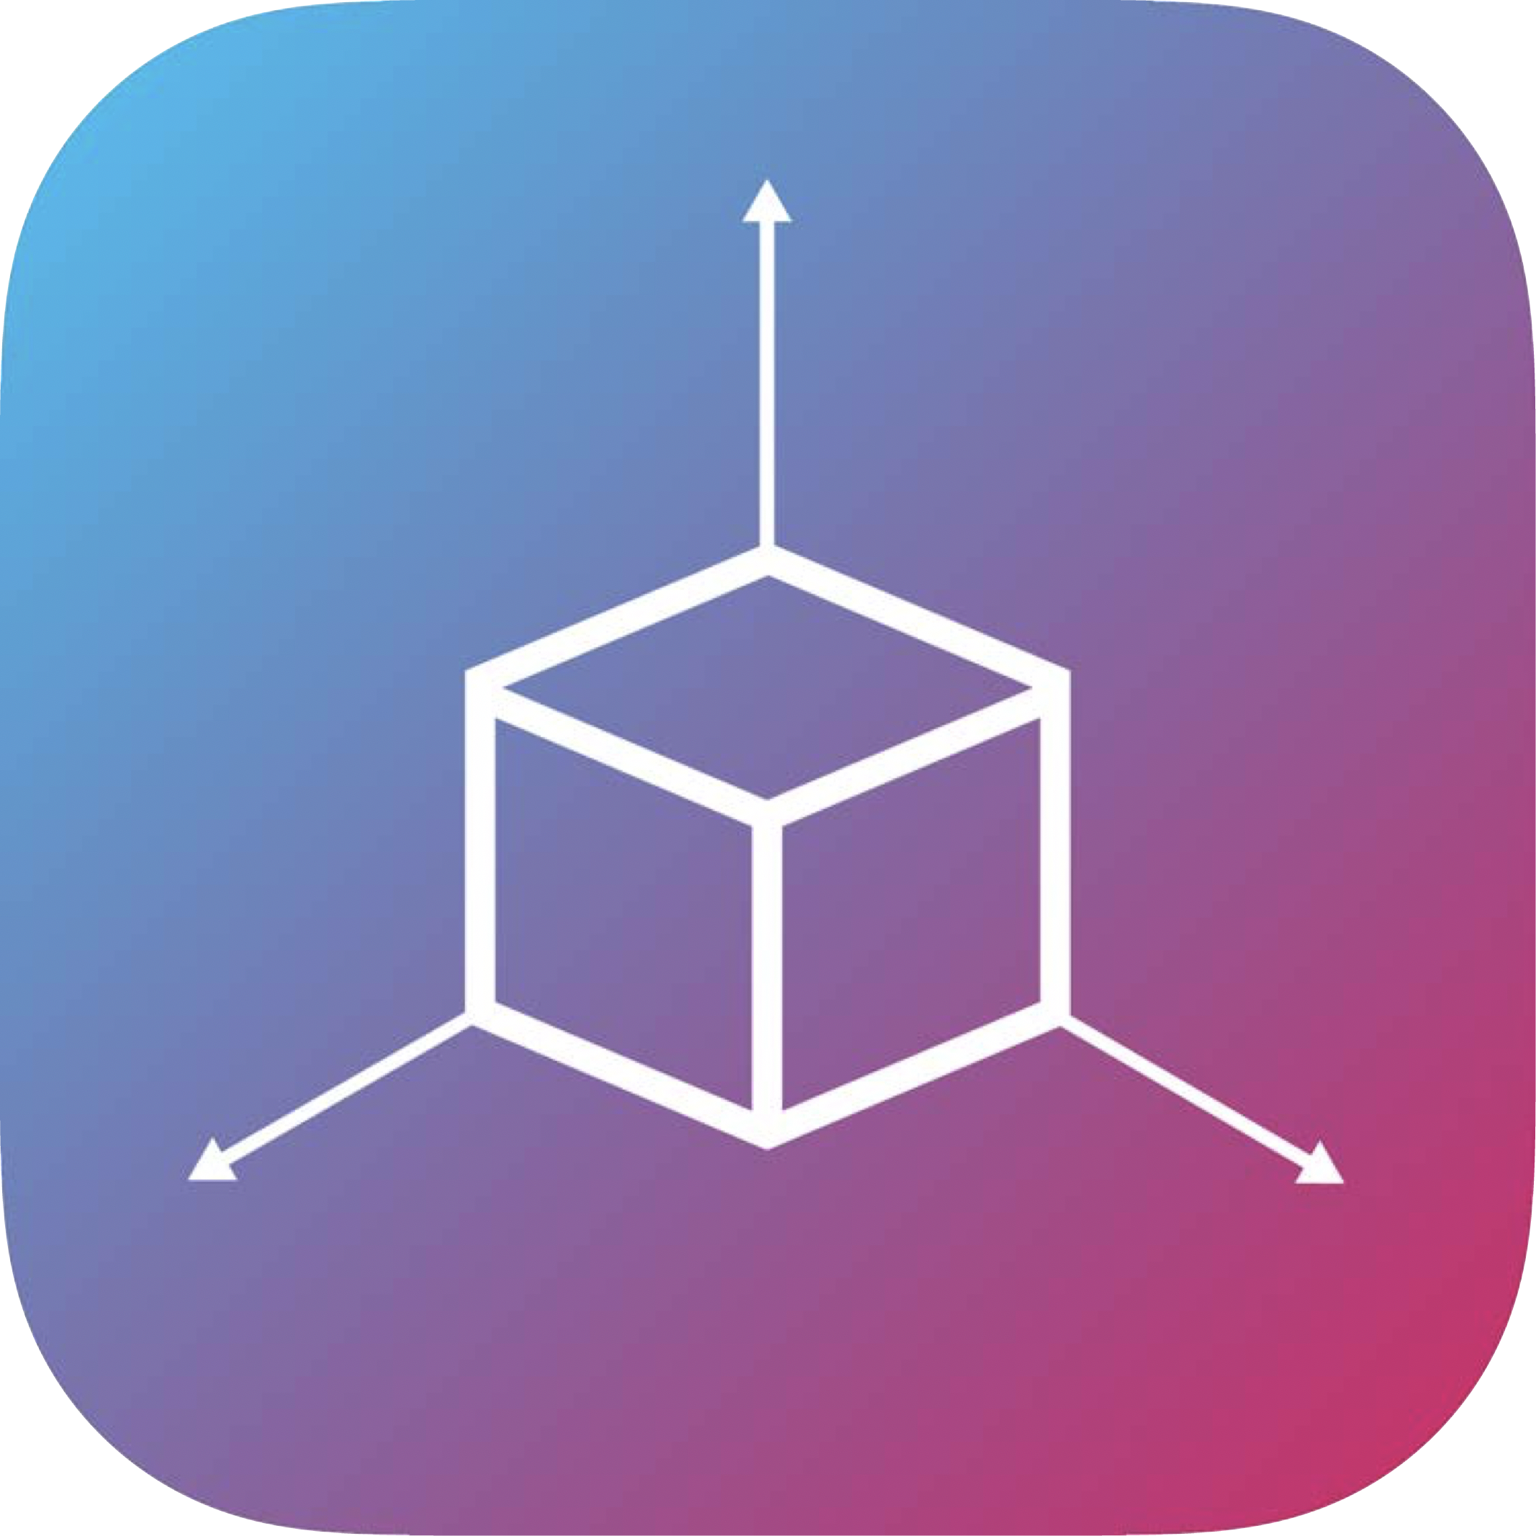
LAYERS
TRACKING
SCENE UNDERSTANDING
RENDERING

Slide 14
TRACKING
World tracking
Visual inertial odometry
No external setup
Notes:
it’s the core functionality of AR
It’s the ability to track your device in real-time
World tracking give the device relative position in a physical world using visual inertial odometry

Slide 15
SCENE UNDERSTANDING
Plane detection
Hit-testing
Light estimation
Notes:
It’s the ability to determine the properties of the environment around your device
Plane detection is the ability to detect surfaces or planes in a physical environment
Hit testing to place objects
Light estimation to correct light your virtual geometry to match that of the physical world

Slide 16
RENDERING
Easy integration
AR views Custom rendering
Notes:
Integration into any render providing camera images, tracking information and scene understanding

Slide 17
REQUIREMENTS
ARCore
x1 Pixel 1 / x1 Pixel 2 / x1 Samsung Galaxy S8
Own computers
A supported Android device
Github repo (PoC)
https://github.com/adidasBCNHackathon/AR-VR
Unity 2017.3.0f2 or higher, with the Android Build Support component
ARCore SDK for Unity
Android SDK version 7.0 (API Level 24) or higher
Notes:
High requirements

Slide 18
REQUIREMENTS
ARKit
x1 iPhone X / x1 iPhone 7
Own computers (MacBook)
iPhone 6s or higher
Github repo (PoC)
https://github.com/adidasBCNHackathon/AR-VR
Xcode 9.0
iOS 11.0 or higher
Notes:
High requirements

Slide 19
Demo AR UNITY ANDROID
AUGMENTED reality

Slide 20
Demo AR IOS
AUGMENTED reality

Slide 21
RESOURCES
Virtual Reality (Google VR)
https://developers.google.com/vr/
Augmented reality (ARCore)
https://developers.google.com/ar/develop/
Augmented reality (ARKit)
https://developer.apple.com/documentation/arkit

Slide 22
adidas
hackathon
2018
THANK YOU

